Slide 1
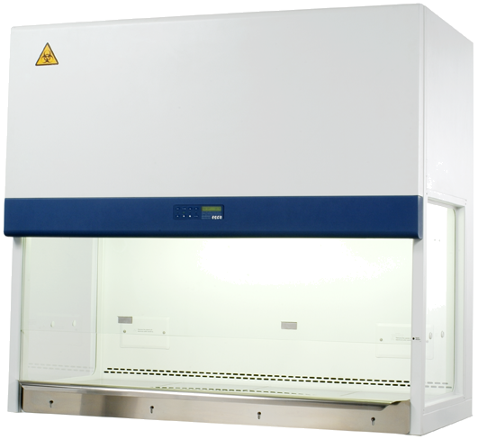
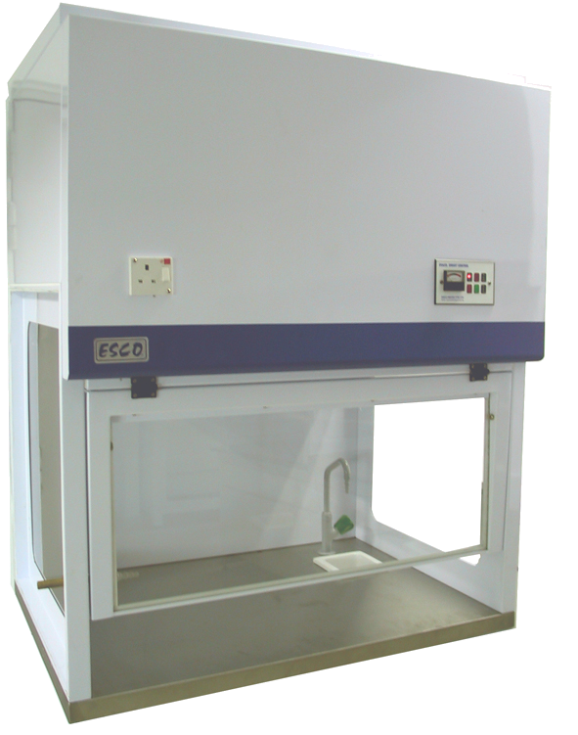
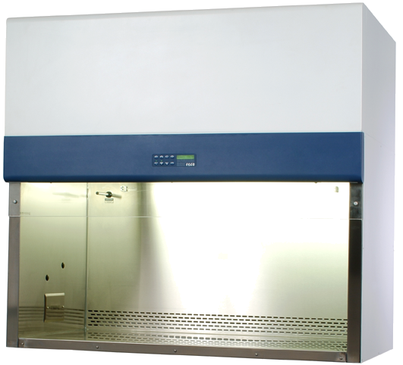
Biosafety Cabinet (BSC)

Slide 2
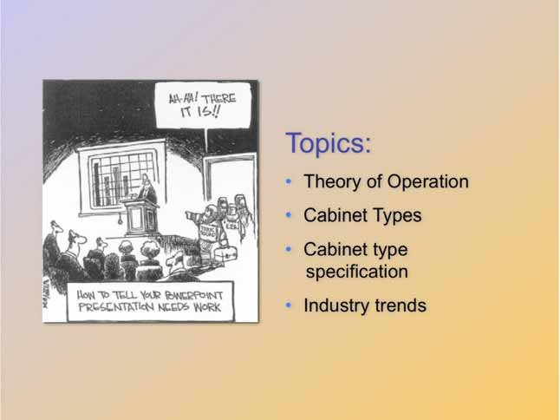

Slide 3
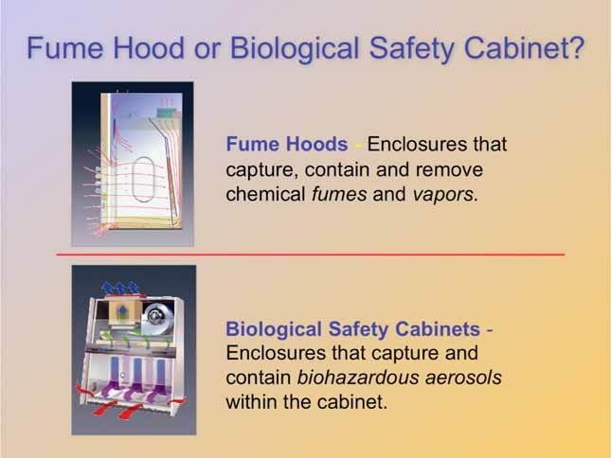

Slide 4
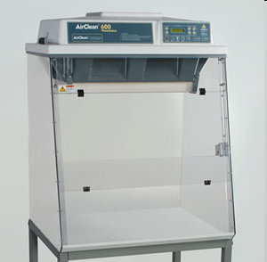
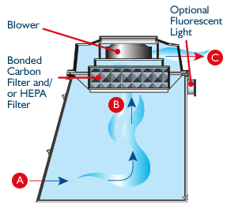
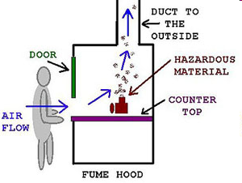
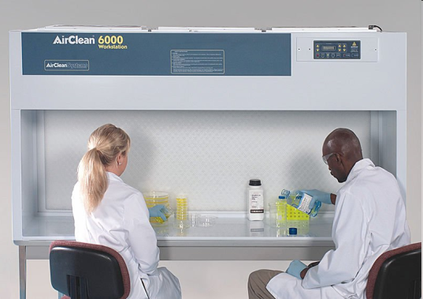
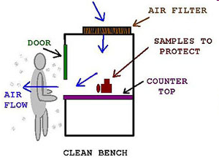
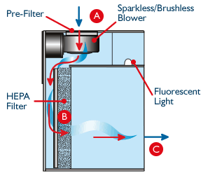
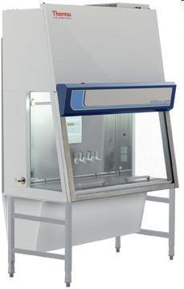
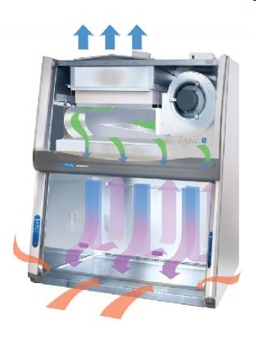
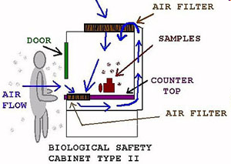
Fume hood
Laminar airflow
BSC

Slide 5
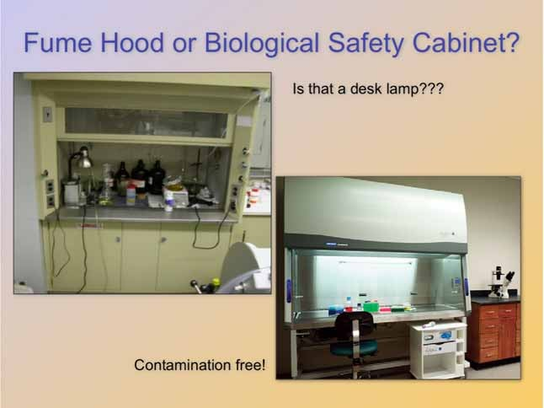
Microbiologists are very concerned about maintaining a contamination-free work area. Therefore, you will notice that a biosafety cabinet is generally cleaned daily and kept free of excessive equipment.
Chemical fume hoods, on the other hand, can often house on-going experiments for months at a time. Since there is usually not a contamination concern, little priority is placed on removing excess equipment.

Slide 6
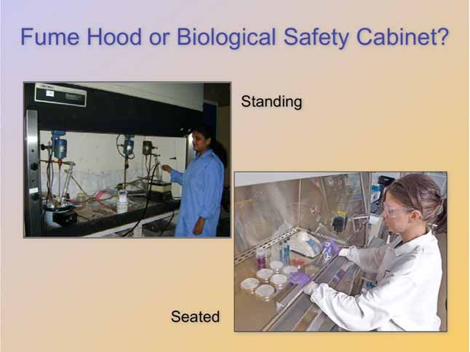
In general, microbiologists work at a biosafety cabinet in a seated position. A procedure can often take several hours. Therefore, there is an emphasis on ergonomic designs of biosafety cabinets.
Chemical fume hoods often have cabinetry located below them, making it difficult to work at while sitting. For this reason, chemists are often observed standing at fume hoods.

Slide 7
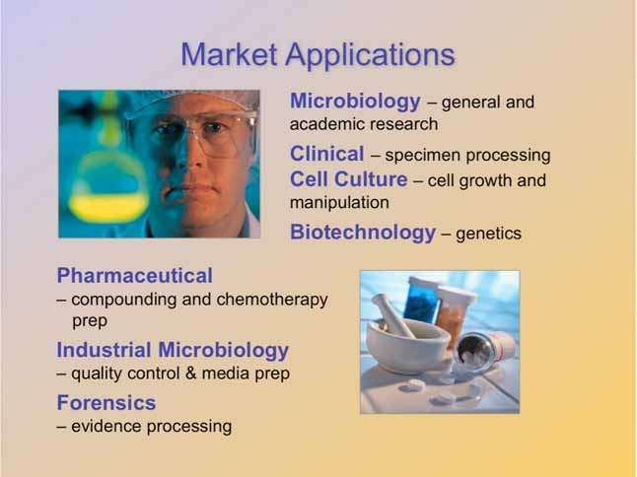

Slide 8
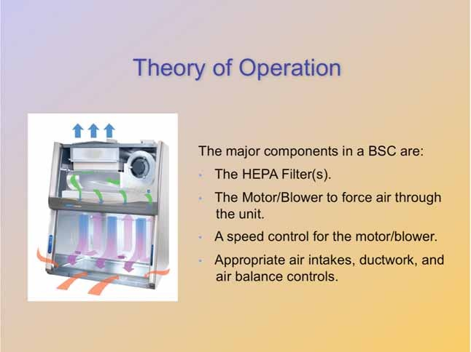

Slide 9
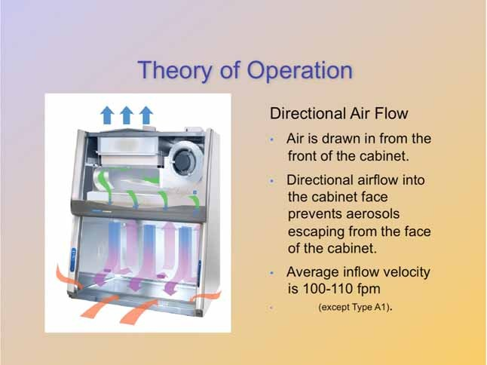

Slide 10
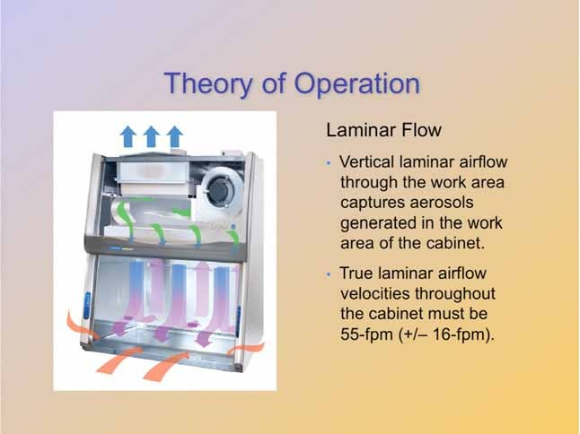

Slide 11
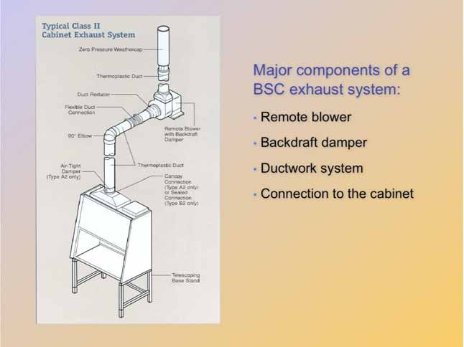

Slide 12
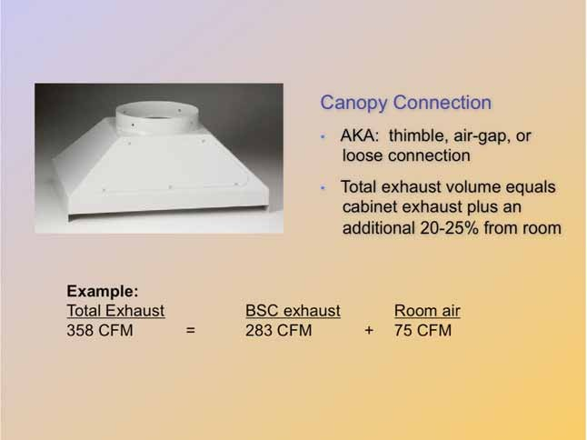

Slide 13
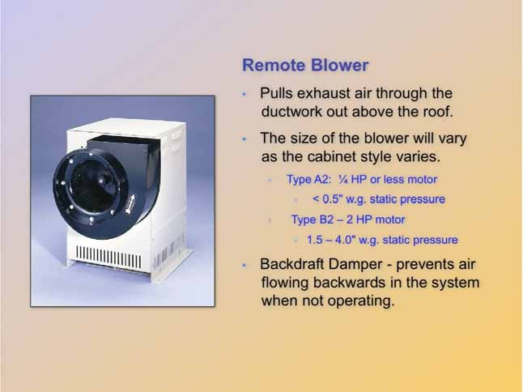

Slide 14
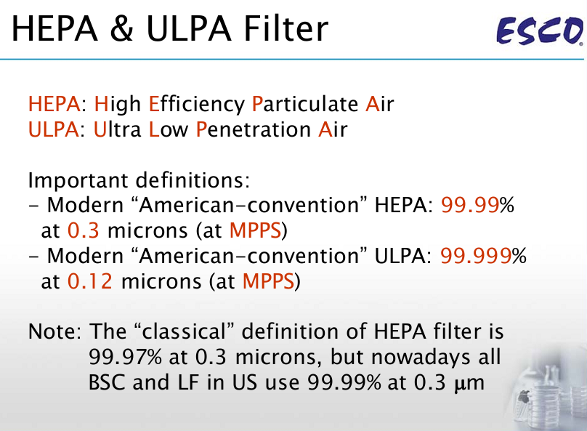

Slide 15
What Is a HEPA Filter and How Does a HEPA Filter Work?
A high-efficiency particulate air (HEPA) filter can remove 99.97% - 99.99% of airborne particles that are equal to, smaller or larger than 0.3 microns in size.
HEPA filters are tested using air particles that are 0.3 micron size as those are the most difficult size for a HEPA filter to catch.
HEPA filters are actually more efficient at capturing smaller-sized particles, like those the size of viruses (Average are 0.1 microns).
This is based on MERV (Minimum Efficiency Reporting Values) ratings as determined by the American Society of Heating

Slide 16
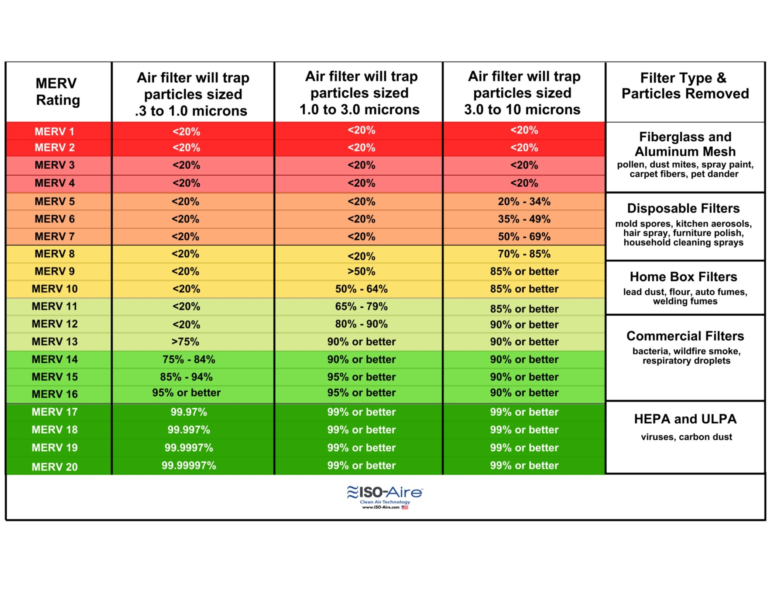

Slide 17
The random, dense arrangement of fibers in the HEPA filter help to catch a range of particle sizes. As air particles pass through the air filter, they are caught by three mechanisms: diffusion, interception, and impaction.
Diffusion occurs in a HEPA filter when the gas molecules that are smaller than 0.1 microns in size collide with each other and are delayed in passing through the filter.
The delay will make it more likely for the next two mechanisms to occur for those smaller particles.
Interception is when particles moving along the air stick to a fiber. Impaction, the third mechanism, is when the larger air particles embed directly into the fibers themselves.

Slide 18
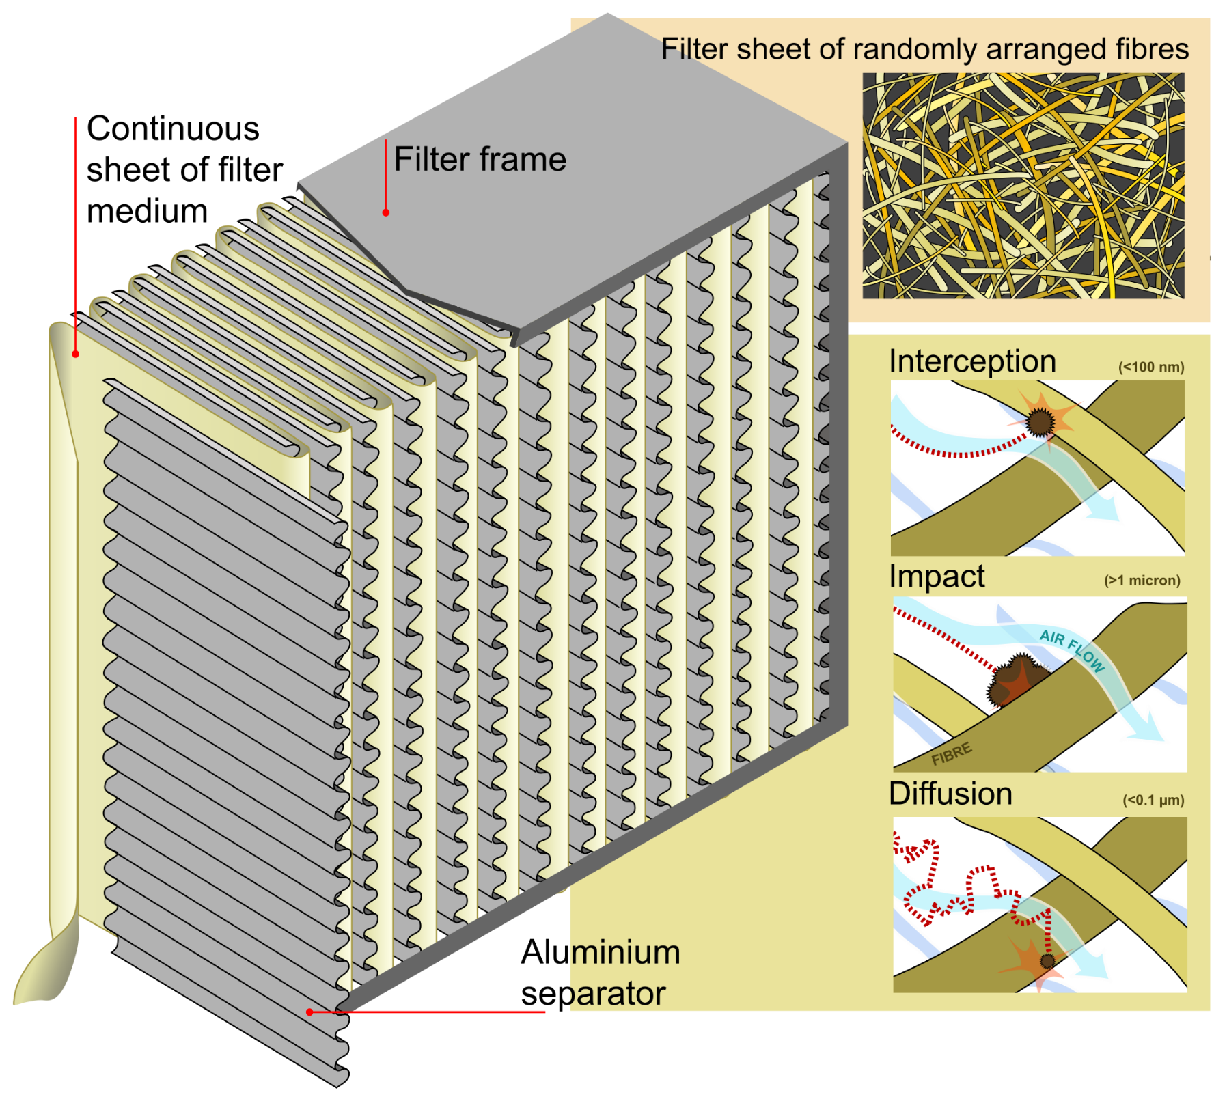

Slide 19
Certification companies for BSC
NSF Standard 49: USA (BSC Class II)
EN12469 : 2000 : EU (BSC Class I, Class II, Class III)
AS 2252 : Australia, Blower 2 set (BSC Class I, Class II)
US Federal Standard 209E Clean Air Classification)

Slide 20
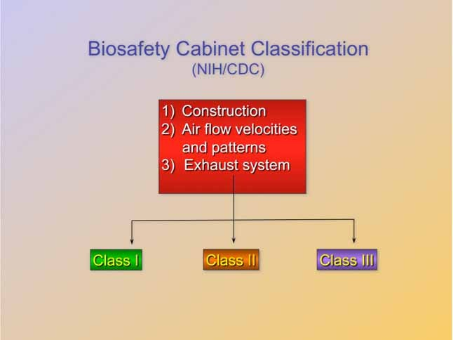

Slide 21
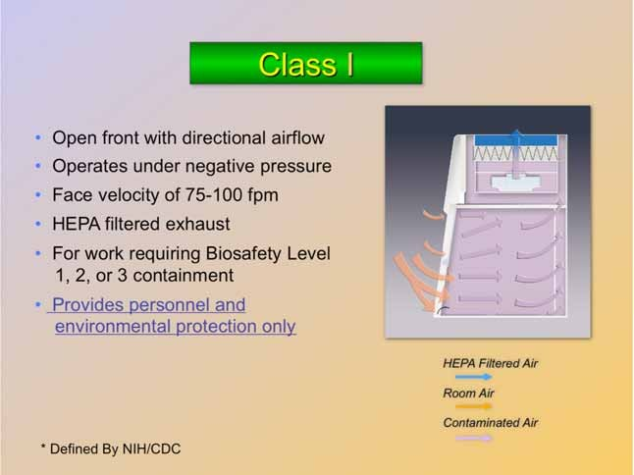

Slide 22
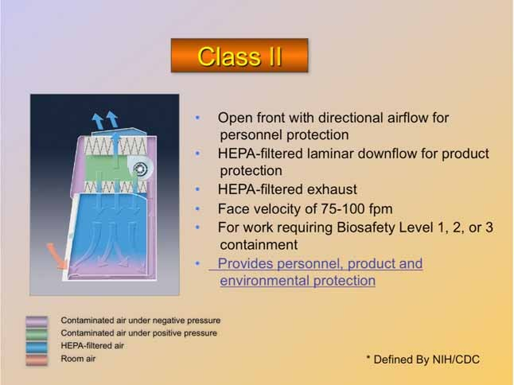
Technically speaking Class I, II, and III are all forms of biosafety cabinets, but the Class II is the most common.
The terms biological safety cabinet and biosafety cabinet are generally used to describe the Class II cabinet. This equipment is the topic for this presentation.

Slide 23
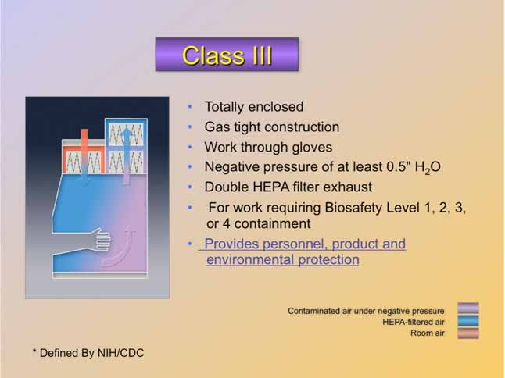

Slide 24
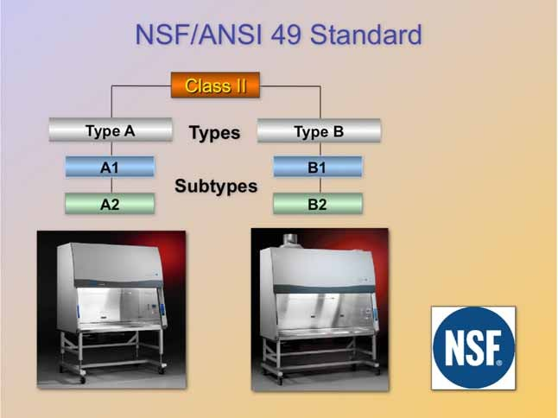

Slide 25
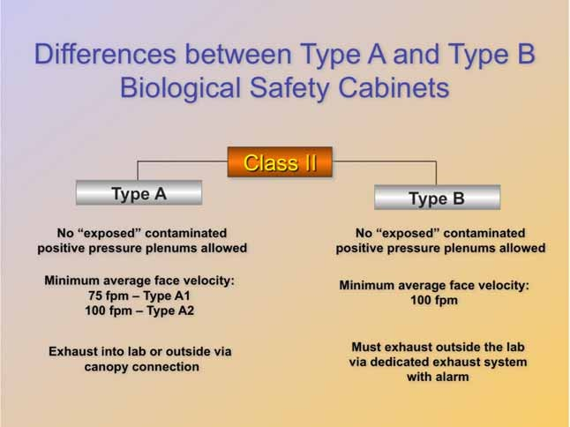

Slide 26
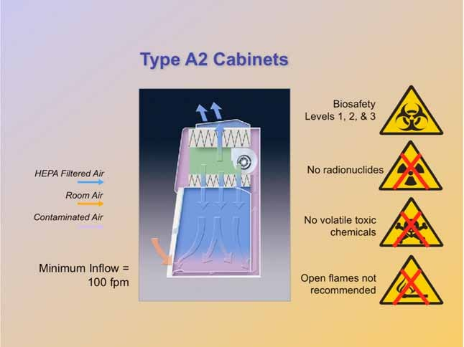

Slide 27
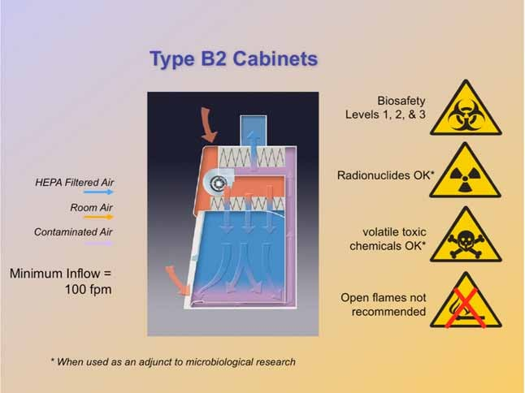

Slide 28
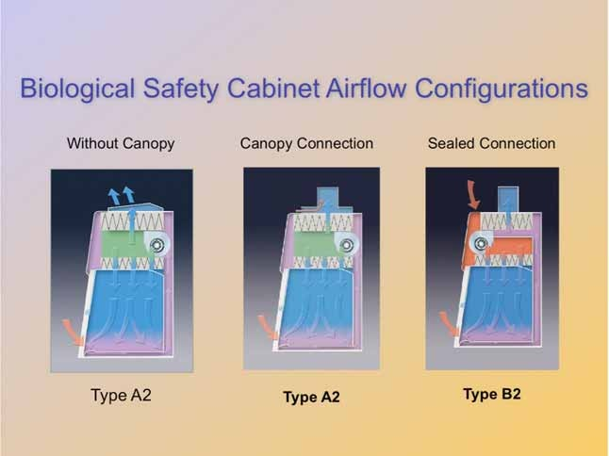

Slide 29
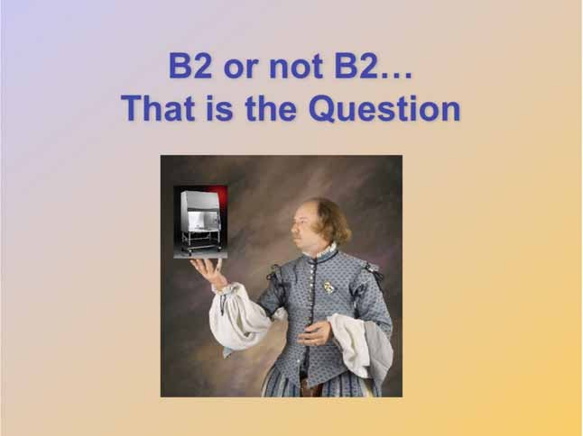
Let us address when to use a Type B2 cabinet versus a Type A2 cabinet.

Slide 30
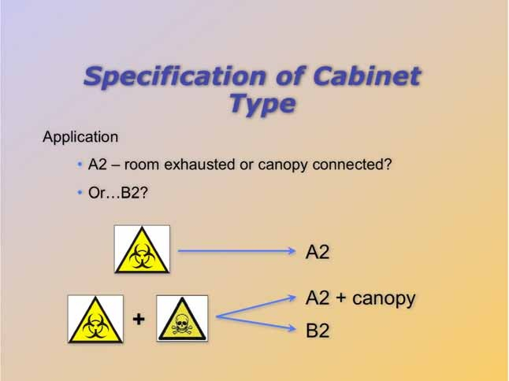
For routine microbiological work, a Type A2 is sufficient. In this scenario, it is preferable to exhaust the cabinet back into the lab.
When volatile toxic chemicals or radionuclides are used in conjunction with microbiological work, the cabinet should be ducted to a remote exhaust system.
If nuisance odors are generated by the work, then a carbon post-filter or duct connection can be used. The carbon post-filter will allow the A2 to exhaust to the room, by removing the odor.

Slide 31
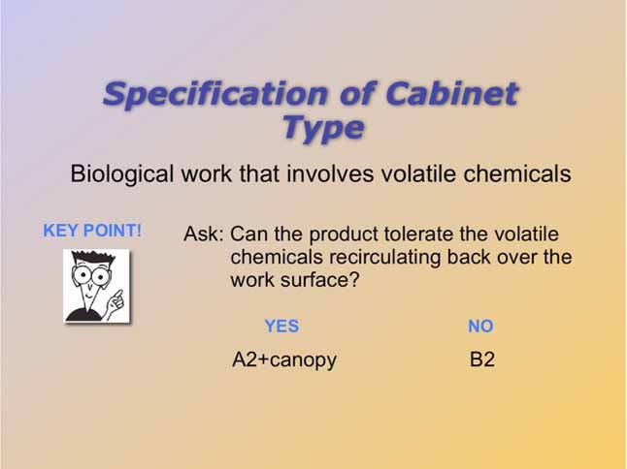
If we know that we need to duct, then we need to answer the above question.
This is the point where it is often mistakenly assumed that we must go straight to the B2.

Slide 32
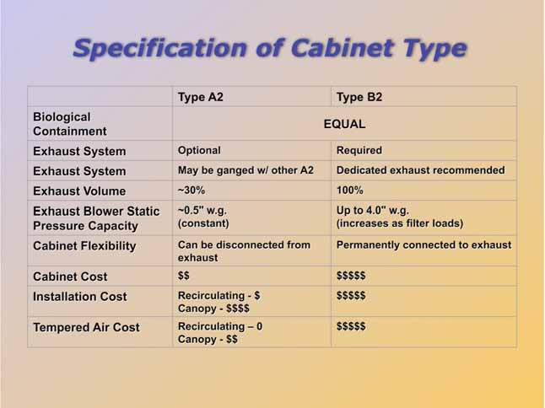
The above chart outlines some very good reasons NOT to use a B2…if it can be avoided. B2 cabinets are more expensive and far less efficient!
Of course if the B2 is right for the application, then this is what should be used.

Slide 33
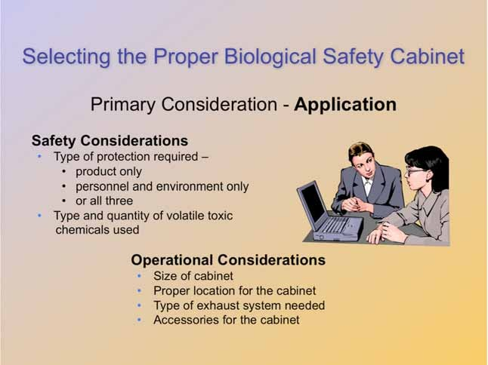

Slide 34
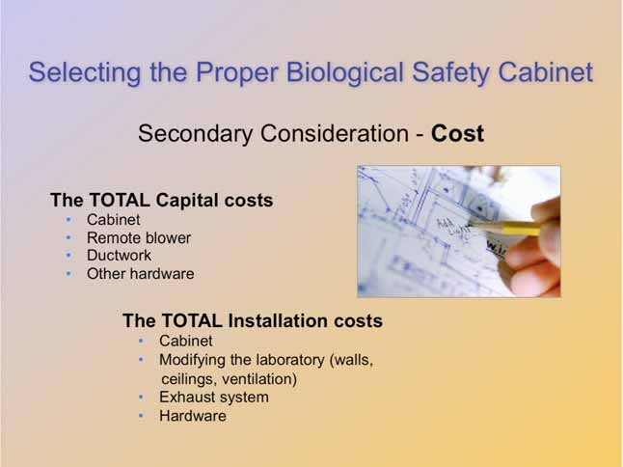

Slide 35
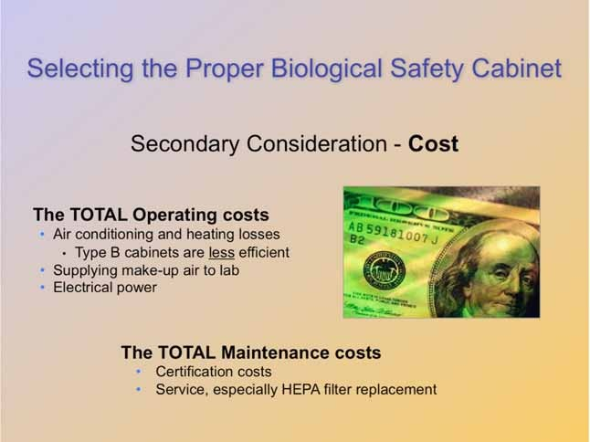

Slide 36
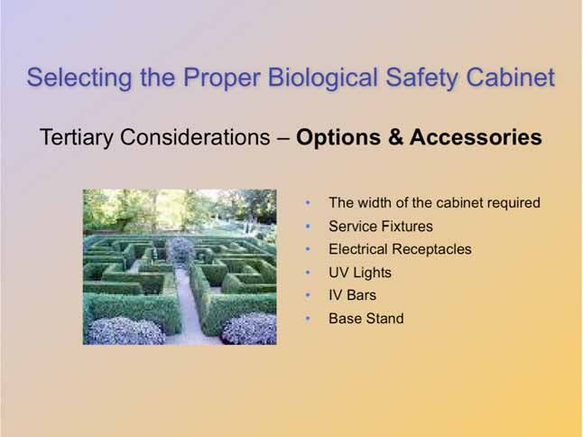

Slide 37
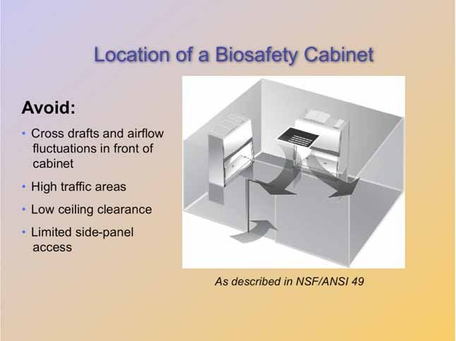

Slide 38
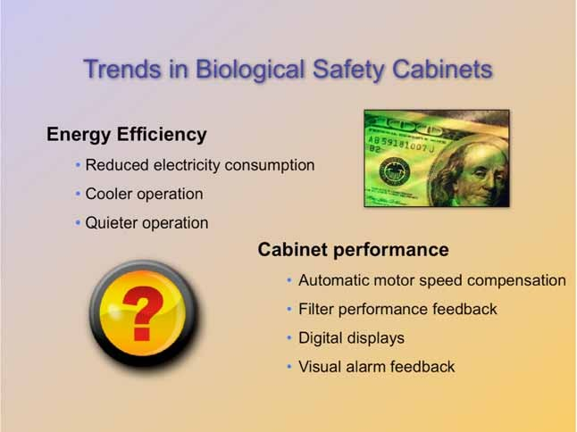

Slide 39
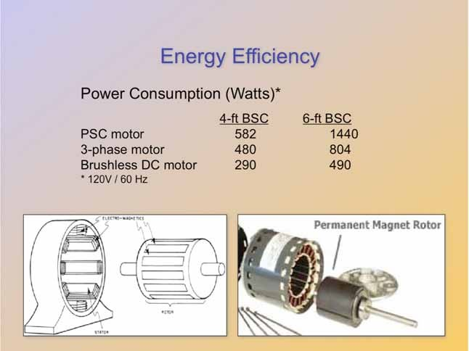
In a PSC motor, the magnetic field must be induced. This generates a large amount of waste heat and significantly reduces the motor’s efficiency.
New motor technologies run much more efficiently. In reality, these “new” motor designs are not new at all. Yet, only recently, did the biosafety cabinet industry begin taking advantage of this motor technology.
The Brushless DC motor, for example, has been used for well over a decade for high-end commercial and residential HVAC blowers. It is also the same motor design in your computer’s hard drive and disk drive, as well as the fan cooling the processor.

Slide 40
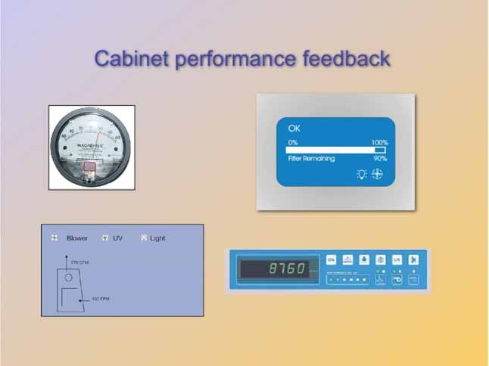
Biosafety cabinet manufacturers are introducing better technology to display how the cabinet is performing.
Old technology utilized a magnahelic gauge to measure differential pressure between pressurized and non-pressurized sides of the filters. This method did not provide the user with a clear understanding of whether or not the cabinet was operating in a safe manner. In fact, most users only knew if there is a problem when the needle of the gauge moved to one extreme or the other (positive or negative).
New technology allows users to monitor the filter life of the HEPA filters, as well as the air flow volume and velocity. New biosafety cabinet designs incorporate real- time automatic adjustment of motor speed to maintain proper air flow.
Market research indicates that biosafety cabinet users find this information much more helpful and intuitive.

Slide 41
